Slide 1
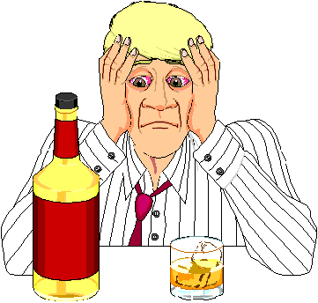
Alcohol

Slide 2
Alcohol
Causes changes in a person’s physical & emotional state = intoxication
Classification = Depressant
All forms of alcohol is dangerous
  1 beer = 1 shot of hard liquor = 1 glass of wine
Lots of “empty” calories

Slide 3

ALCOHOL
Alcohol is the most used & abused drug in America today.
  Is there a problem?
    2 out of 3 murders
    1 out of 3 rapes
    1 out of 3 suicides
    2 out of 5 cases of assault
    3 out of 5 cases of child abuse
    Are all connected to the use of alcohol!

Slide 4
WHAT IS ALCOHOL?
A substance formed naturally when fermenting sugar reacts with yeast… ethyl alcohol
  Different alcoholic beverages use different sources of sugar
    Beer is made from barley
    Wine is from grapes and berries
    Whiskey is from malted grains
Ethyl alcohol causes the intoxicating effects in booze

Slide 5
ALCOHOL AND “DIGESTION”
Alcohol is absorbed directly into the bloodstream from the stomach & intestines
It’s better for someone to drink with food because alcohol cannot be absorbed as rapidly
  Drinking on an empty stomach will speed up intoxication

Slide 6
ALCOHOL’S AFFECT ON PEOPLE
Once in the bloodstream, alcohol goes to all parts of the body
The brain is the most sensitive organ to alcohol
Why is this the worst organ to be affected by alcohol?

Slide 7

What A Drink Does Right Now!
Slows nervous system down- Depressant drug!
15 minutes after 1 or 2 drinks
  More relaxed & talkative, laugh more easily
After only 2 drinks
  Loses ability to make good decisions
  Unable to pay attention & follow complex thought
  Loses inhibitions
After a few more
  Loses ability to focus eyes
  Slurred speech
  Loss of coordination
  Mood swings

Slide 8
ALCOHOL’S AFFECT ON PEOPLE
Alcohol is eliminated from the body at a fixed rate.
  5% is eliminated from breathing, urinating, and perspiring.
  95% is burned at a rate of about one 12 ounce beer, or one 5 ounce glass of wine, or one 1 ½ ounce shot of hard liquor per hour (oxidized in the liver).
  Taking a shower, eating a lot, fresh air, or drinking coffee WILL NOT sober you up any faster!

Slide 9
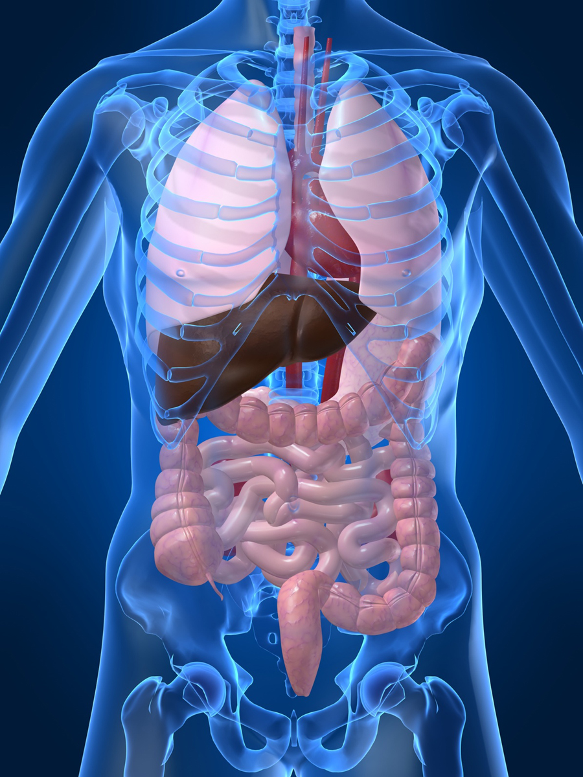
LONG TERM HEALTH PROBLEMS
Heavy use of alcohol damages body functions:
  including brain (memory loss)
  heart (heart attacks from fatty deposits)
  liver (cirrhosis: orange/yellow disease of the liver in which scar tissue replaces healthy tissue and blood cannot flow through properly resulting in the body’s inability to break down fats)
  circulatory system (Type 2 diabetes)
  stomach (too much acid leads to indigestion, heartburn, and ulcers)
  intestines (diarrhea)

Slide 10

ACTUAL EFFECTS OF ALCOHOL
Everyone is affected differently by the same amount of alcohol because of the following 6 factors:
  Body weight
  Food in stomach
  Use of other drugs simultaneously
  Experience with alcohol
  Speed of drinking
  This specifically has to do with levels of intoxication.

Slide 11
Drink & Driving,
A Deadly Combination
#1 cause of death among teens is car accidents
All skills for driving are impaired
  Slows reaction time
  Reduces ability to judge distance & speeds
  Affects vision
  Reduces concentration

Slide 12
How much does a DUI Cost for a teen?
Estimated minimum $45,435

Slide 13
This is just the bare minimum, doesn't include costs if someone is killed or the guilt you will live with for the rest of your life.
Annual auto insurance increase over 13 yrs = $40,000
DUI classes = $650
Towing & storage fee ($137 a day) =$685 (at least 5 days)
Fines & attorney fees = $4,000
DMV reinstatement fee = $100
Estimated Minimum total = $45,435
Doesn't include hospital care for the person you hurt, the emotional & physical costs, the inability to get a job because of the DUI record, or the award from any lawsuit resulting from a death. All together, those costs could total millions of dollars.

Slide 14
The time spent dealing with the consequences:
Average time of license suspension = 3 months for adults, 1 year for teens
Average time in jail = 6 months
Average years on probation = 3 years
Number of years with 2 points on driving record = 13 years
DUI classes = 6 months
Time in court = Several months
Convicted of murder = Possible lifetime imprisonment

Slide 15
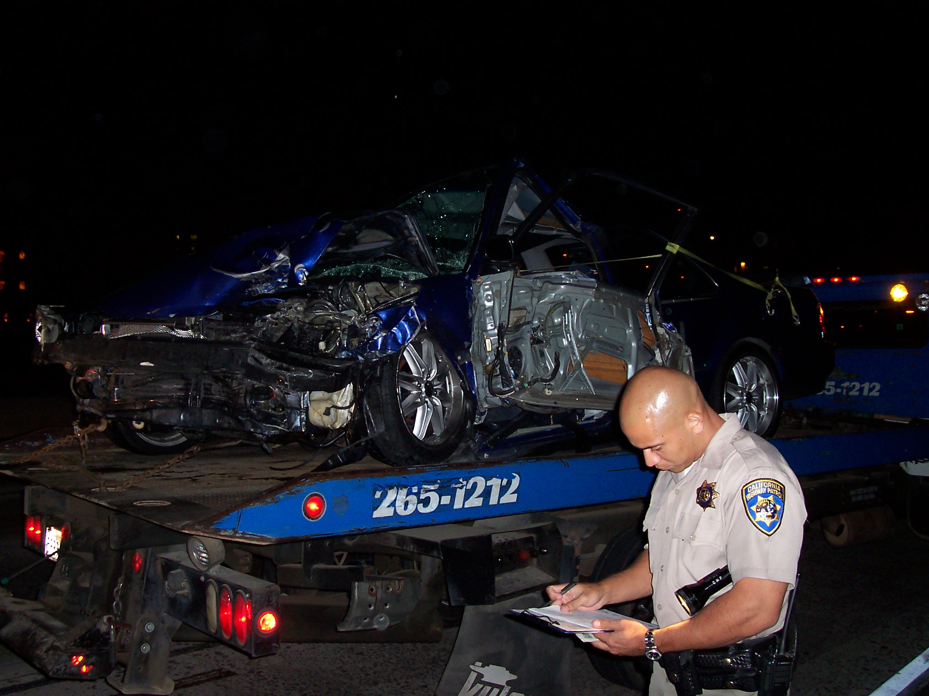

Slide 16
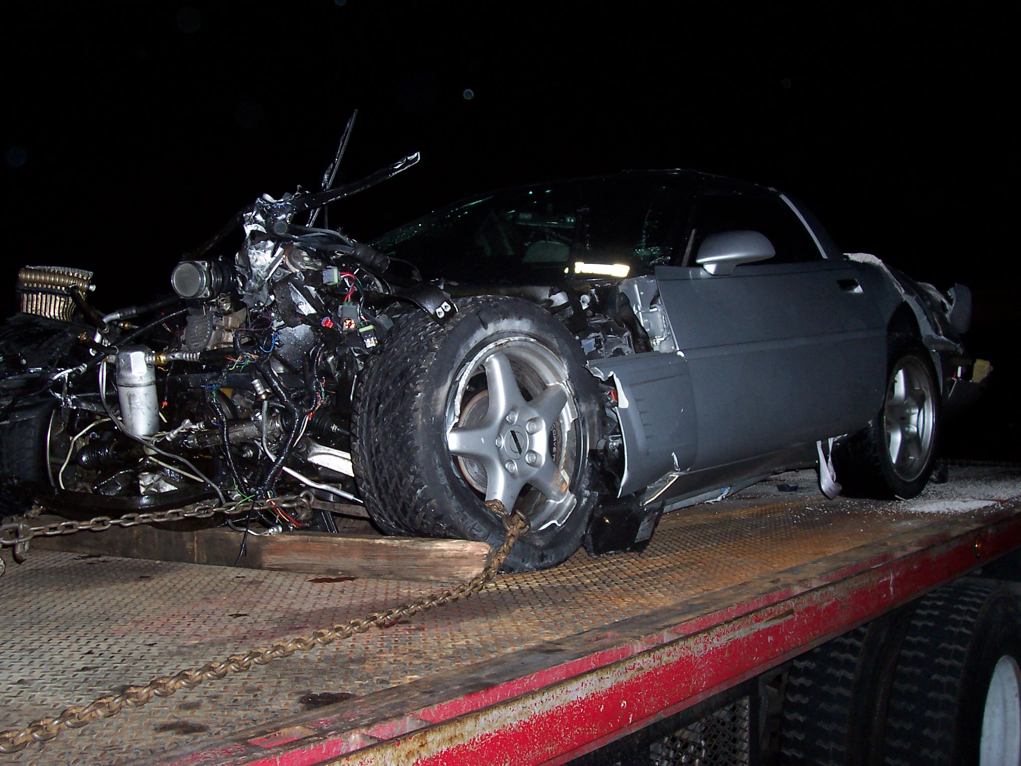

Slide 17
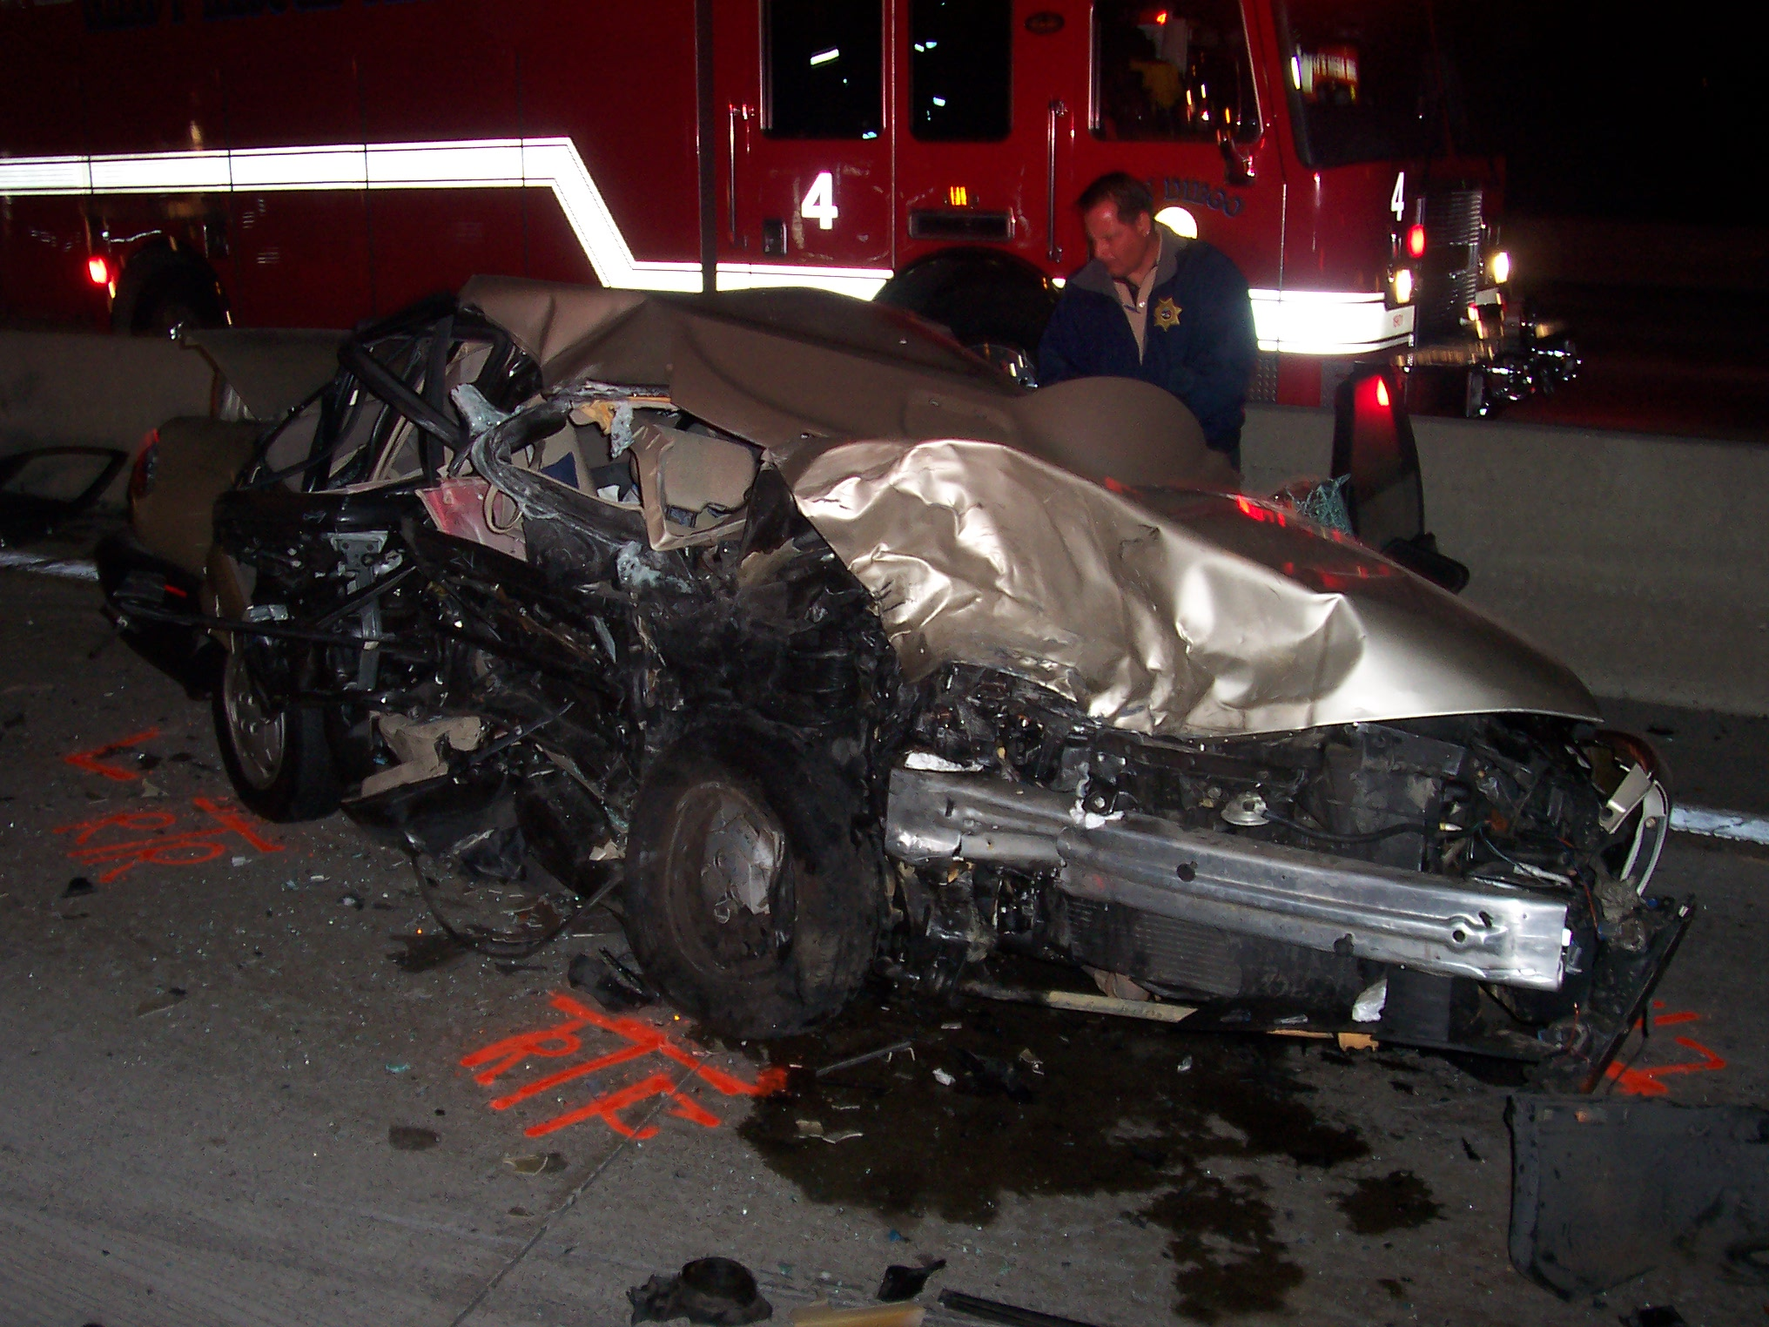

Slide 18
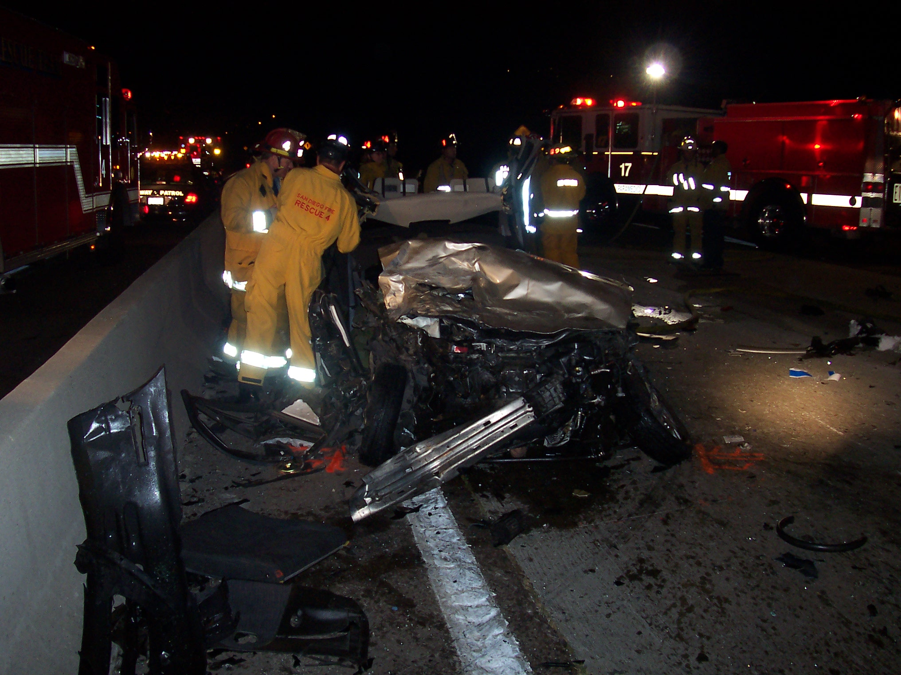

Slide 19
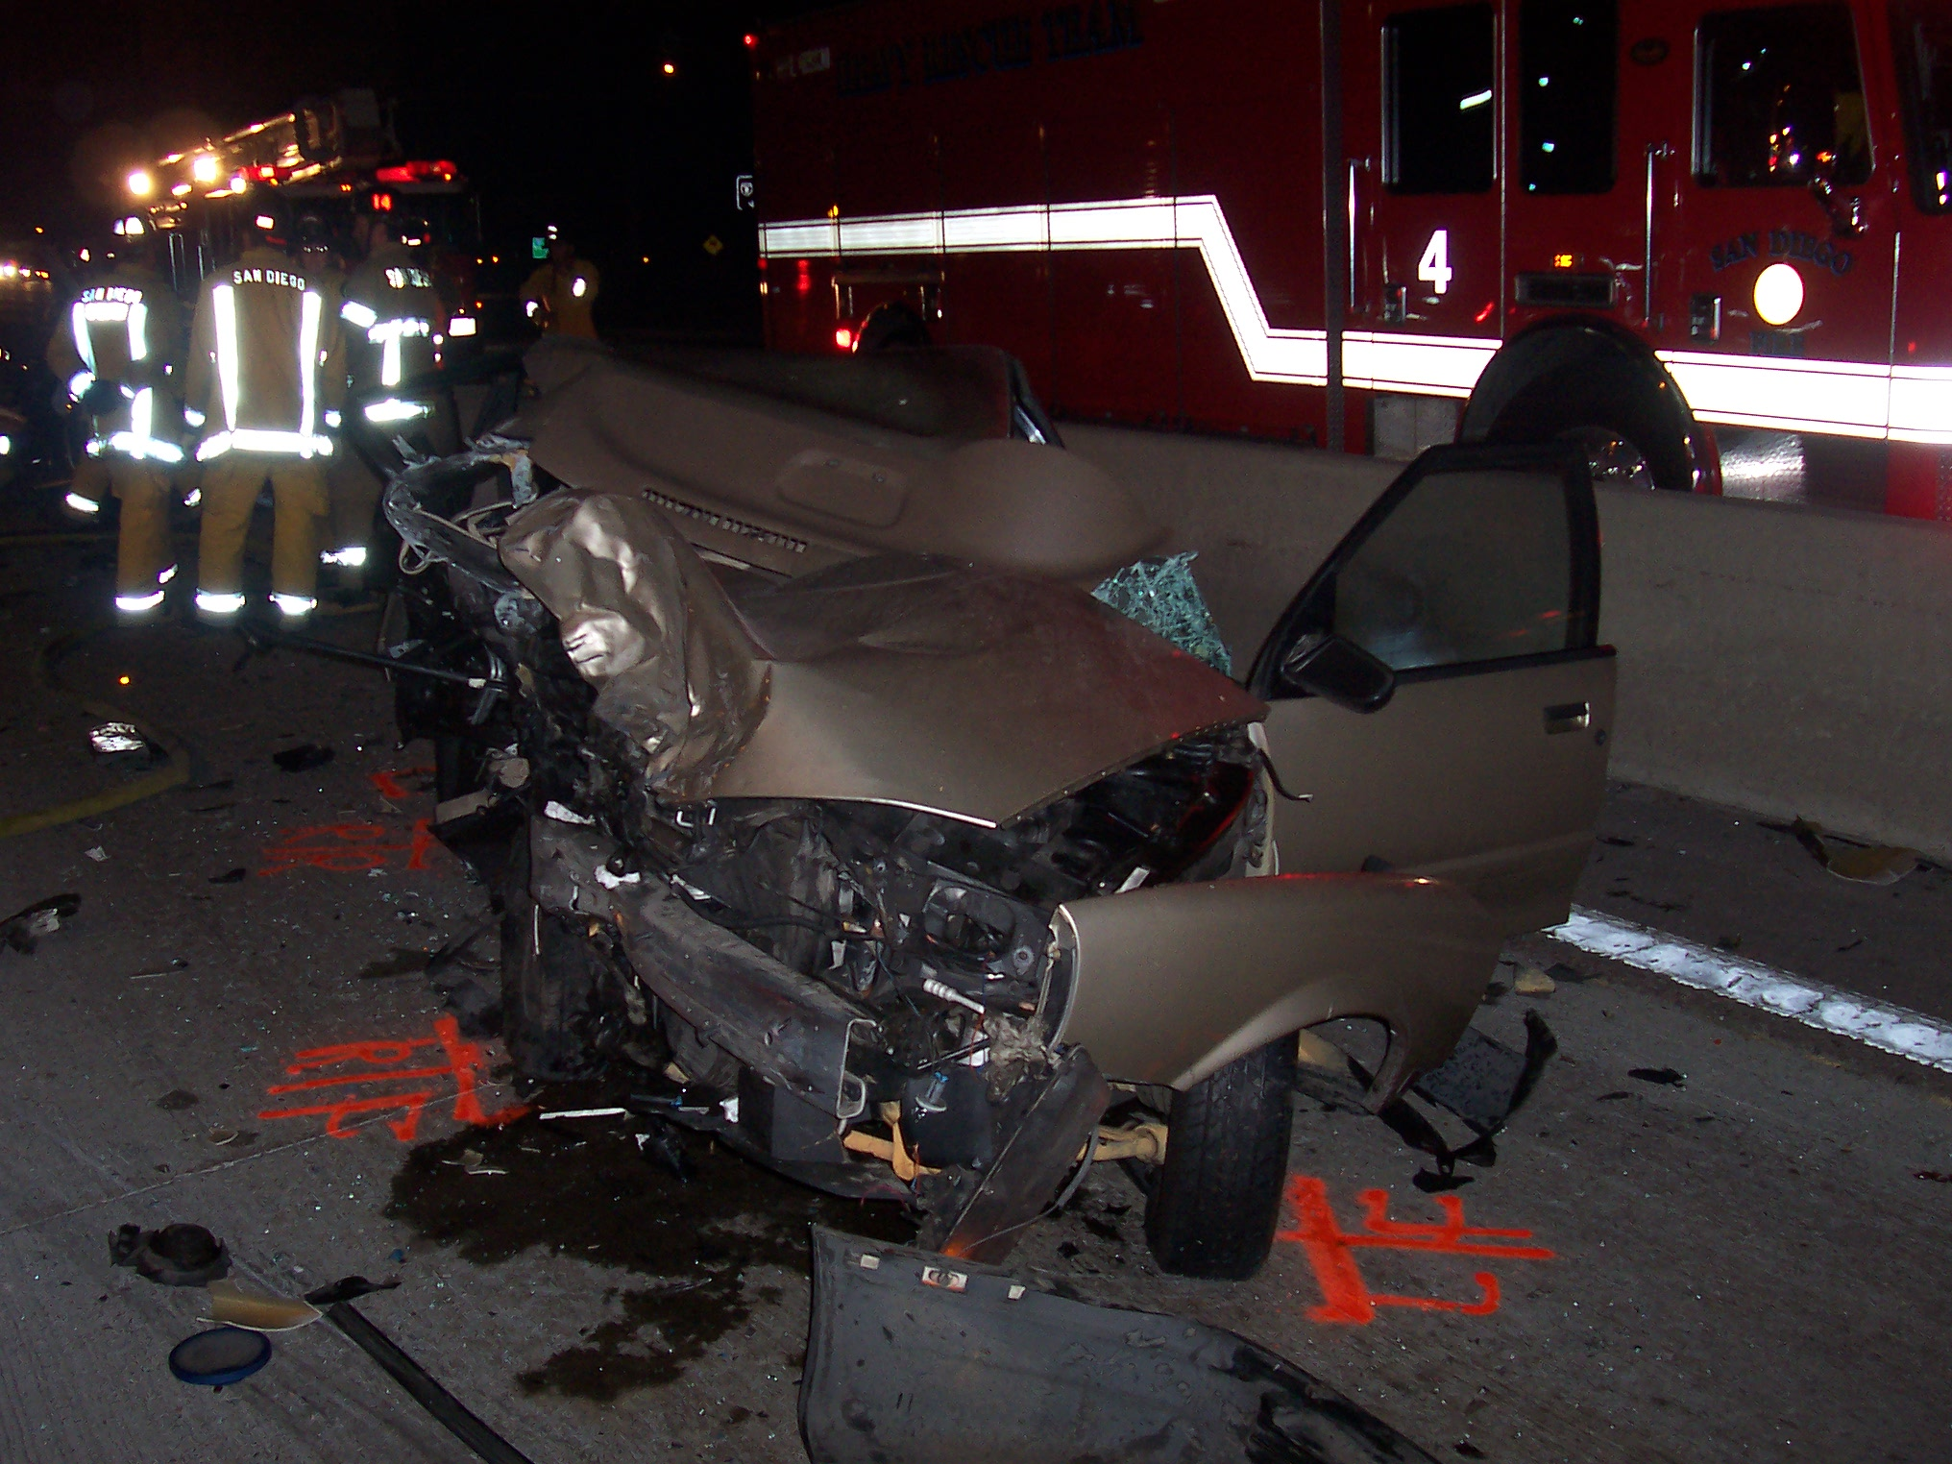

Slide 20
Most Important Things To Remember
Do NOT drink and drive!!
Do NOT get in a car with someone who has been drinking!!

